Slide 1

GPS Clinic NATRC National Convention
Bill Wingle
Albuquerque, NM
February 10, 2018

Slide 2
What Will You Learn Today
Why should you use GPS at a CTR?
They help you:
Stay on Trail
Getting lost $%&#’s!
Determine how far you’ve gone
Determine how long you’ve been riding
Determine how fast you are going
Determine where you are

Slide 3
GPS Basics
What do they do?
What they don’t do.
How accurate are they?
Now you can leave your map at home!
WRONG!
Types of GPSs and GPS Apps

Slide 4
Why is Having a GPS Important?
Being able to look at your GPS and say, “I’m on (or off) trail” gives you confidence.
Avoids lost time and stress.
They can help to pace you and your horse.
Am I on time?
Do I need to slow down/speed up?
People get distracted and lose track of where they are.
People make wrong turns / get lost.
Trail markings may not be adequate.
Not enough markings for riders new to ride.
Ribbons and signs disappear.
Animals eat them. Wind knocks them down. Other people take them.
If you have to abandon the ride, A GPS may help you get back to camp or another rescue point.

Slide 5
A GPS: What Does It Do?
Use satellites to triangulate your position
Using the position (distance and direction) and Doppler affects of multiple satellites
Shows you where you are
Tells you were to go
May tell you where you’ve been
Specifies your exact location when you call 9-1-1

Slide 6
Can They Track You?
GPS signals are one-way. They can’t be used to track you.
With additional hardware, yes they can.
SPOT
Call for help from almost anywhere in the world.
Transmit where you’ve been, and maybe where you are.
Send texts.
Smartphone tracking software.
Update locations to websites.
Dependent on cell service.

Slide 7
How Accurate Are They?
Professional units, with correction are accurate to the sub-millimeter
Handhelds
WAAS are accurate to 10’ *
Using Doppler only, about 50’ *
Satellite imagery: You can see that tree or building
* This is under ideal conditions

Slide 8
Can I Leave My Map at Home?
No! The following are from personal experience
GPSs fail
Batteries die, electronics fail and misbehave, solar flares mess with satellite signals
GPSs mislead
They track your movement precisely, but are a mile off
They are only as good as supporting data
GPSs lie
They say you are still at your last ride
They say you rode 160 miles today
Use your head

Slide 9
Types
Basic Navigation ($100 or less)
Distance and speed only.
Not what I recommend for NATRC
Wrist / Watch ($200 - $1000)
Battery life (?), tiny maps if supported.
Mapping Handheld or Wrist GPSs
Smartphones

Slide 10
Good For NATRC
Mapping Handheld or Wrist GPSs ($150 - $1000)
Pros:
Very durable
Weather proof
Handle bouncing on horses, some drops.
Moderate to good battery life
Multiple days on a couple AA’s
Easily replaceable batteries
Off-road navigation tools
Accurate compass
Cons:
Screens are often small and hard to read
An extra piece of expensive equipment
Maps (usually extra $’s)
Satellite imagery available but often requires an annual subscription

Slide 11
Good For NATRC
Smartphones
Pros:
You likely already have one
Free or cheap software and maps
Sufficiently accurate, satellite imagery, navigation
Off-grid maps
Compass (trustworthy?)
Fairly easy to share GPX tracks
This can be an older, retired, phone without an active data plan.
Cons:
Durability, (weather, drop, …)
Battery Life (airplane mode helps)
Bring a spare battery pack.

Slide 12
Mapping GPS Features
Time, distance, speed
Location
Coordinates and map location
Navigation
Compass
Map
Routes
Tracks (breadcrumbs)
Waypoints

Slide 13
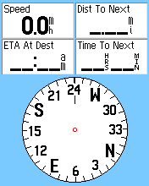
Navigation
Compass & bearing
Current calibration or movement.
Know how it works on your device.
Waypoints / POI’s
Routes
Major POI’s with an order
Tracks
Waypoints every ~50’
Essentially a continuous line
Waypoints, Routes, and Tracks can be used together

Slide 14
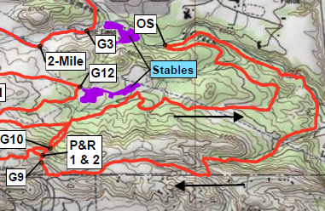
Waypoints
In NATRC, these are usually timing points, or other points of interest.
The GPS has no information about order, or even if order is relevant
Knowing where a waypoint is, doesn’t mean you can easily get there

Slide 15
Tracks (aka Breadcrumbs)
These form continuous lines
Stray from the path, and you can easily move back
They define the path to follow between POI’s
Tracks don’t define direction
i.e. they don’t tell you to go east or west down the trail

Slide 16
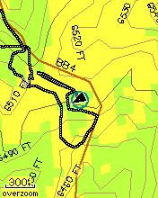
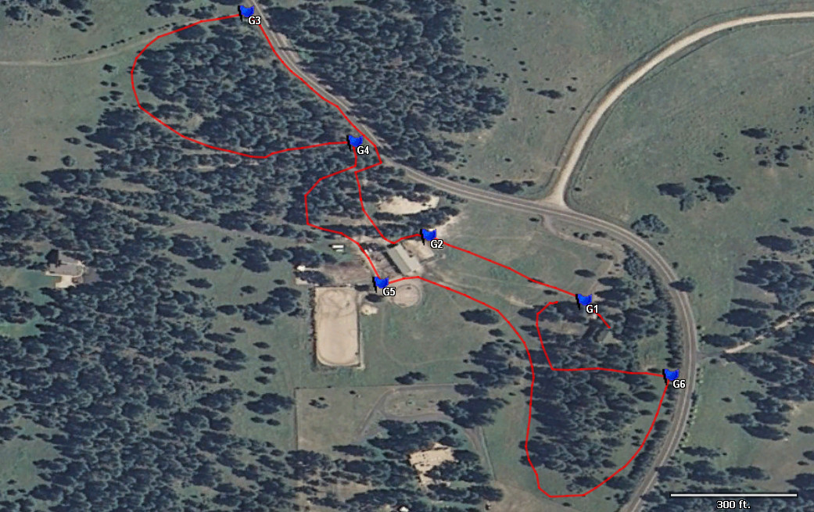
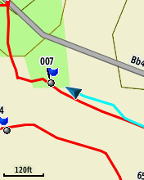
Tracks (cont)
Where am I?
Zoom out and look for patterns
Zoom in
Which way do I go?

Slide 17
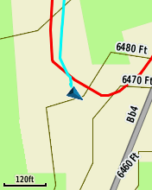
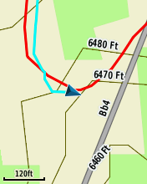
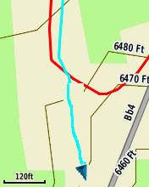
Tracks (cont)
How do I get back on track?
I’ve missed a turn. Where do I go?

Slide 18
Using a GPS for a NATRC Ride
Turn it on and warm it up (5 minutes).
Smartphone are always on so less of an issue.
Timing out.
Time, distance, speed.
Location.
Waypoints and proximity alerts.
On the trail analysis.
What to do when the mileage is off.
Mileage will rarely match the map.

Slide 19
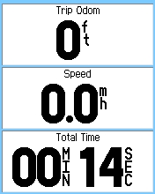
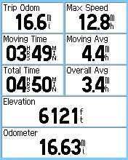
Screens I Use 99% of Time
Trip Information
Map

Slide 20
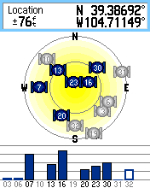
Turn it on and warm it up
Check the batteries
A GPS may take 5 minutes to find itself if you are at a new location
Turn it on when you put it on your wrist/horse/…
Also, remember to turn it off when you get back into camp.
This applies to smartphone apps as well.

Slide 21
Timing out
Have the GPS ready to be reset before you get to the timer (if possible).
When timer says “your out”, finish reset/start process.
Have a fallback timer.
Mark the minute on your watch if you can.
Knowing what time open timed out can help you guess when you timed out.

Slide 22
Timing out (cont.)
People are using more devices and apps now.
For different devices and apps I have some more individualized instructions.

Slide 23
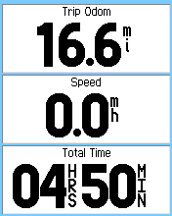
Time, Distance, Speed
On a well marked trail, you will spend most of the time looking at
Total time
Speed
Distance
Am I on time?
How far is it to next timing point (check map)?
Am I going to fast / to slow?

Slide 24
Location
Where am I?
Zoom Out
Zoom In
Which way do I turn?
Do I turn here?
Am I on the trail?
I missed a turn! Where and how far back is the trail?

Slide 25
How to I Get Ride Tracks?
Assuming someone has made tracks:
For handheld GPSs someone at the ride can load them. This requires someone with a laptop.
For smartphones, tracks probably need to be made available before the ride.
The method to load the tracks varies by the app.
MotionX (iPhone) allows Facebook shares or a pre-registered e-mail message.
US Topo Maps Pro (Android) works well with e-mailed tracks.

Slide 26
Smartphone App’s
There are many GPS apps available. Most aren’t well suited for NATRC.
What I want to see:
Ability to show
Total time on trail (setting zero at ride start should be easy).
Total distance ridden.
Current speed. The less this is a moving average, the better.
Ability to easily load GPX tracks and waypoints made by someone else.
Good base map(s).
Ability to pre-load maps for off-line use.
Pre-loaded track and rider track should be different colors.
Ability to re-center on current location.

Slide 27
iPhone App
MotionX ($2)
Fairly easy to use.
Shows time, distance, speed.
Good maps.
I haven’t figured out how to make the ride track and the current users track different colors.
Easy to share tracks.
Facebook, though there appears to be a size limit.
E-mail.
GPX tracks made using other GPSs can be e-mailed to MotionX and they will send you a link others can access via the MotionX app.
Once in MotionX, tracks can also be shared on Facebook.

Slide 28
Android App
US Topo Maps Pro ($12, Free version insufficient)
Fairly easy to use.
Shows time, distance, speed (user can select what to display)
Many good base map options.
Ride track and the current users track colors can be defined by user.
Easy to share tracks.
E-mail.
Will load any (?) GPX track e-mailed to user from e-mail app.

Slide 29
Questions?
…

Slide 30
Let’s Go For a Walk
Let’s get apps and tracks loaded.
We are going to take a short walk with several waypoints and follow a track.

Slide 31
Contest
10 POI’s are located in Old Town.
Go find then and tell me what store or object of interest they are next to.
Winner with most correct, or by drawing if tied, win two Riding Warehouse Raffle tickets.

Slide 32
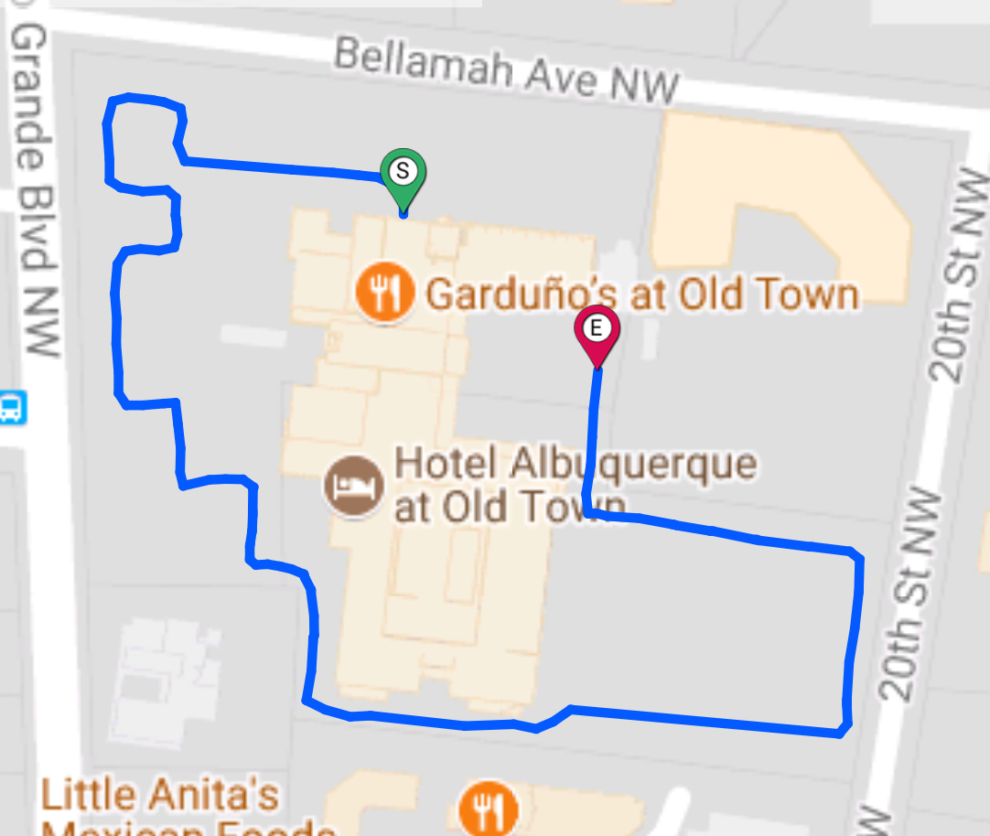
The Trail
S – 0.00
P1 – 0.16
P2 – 0.30
E – 0.47
P1
N
P2

Slide 33
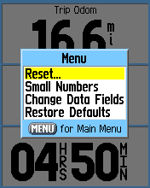
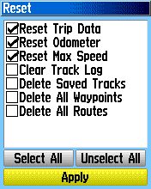
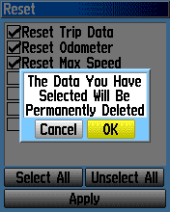
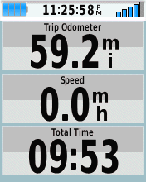
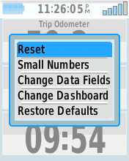
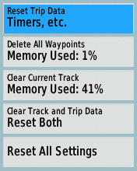
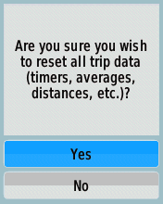
Practice Timing Out
Garmin etrex Legend/Vista (old)
Garmin etrex 20/30

Slide 34
Tasks on the Trail
Go to the start point A
Walk to the parking lot following the track
Deliberately walk off track
See that you are off track
Zoom out to get big picture
Zoom in to get detail
Follow trail and return to the meeting area

